Slide 1





Development of a wiki-based, expert community-driven nanosystem vocabulary
International Conference on Dublin Core and Metadata Applications October 3-6 2006 Mexico
Metadata for Knowledge and Learning
Laura M. Bartolo, Cathy S. Lowe Sharon C. Glotzer, Chris Iacovella
Kent State University University of Michigan

Slide 2
Outline
Background
Introduction
Methods
  Participants
  Software & Procedure
Results
Discussion

Slide 3
Soft Matter
What is it?
  Organic materials -- polymers, biomolecules, liquid crystals, surfactants, and proteins
What disciplines are involved?
  The fields of biology, chemistry, engineering, materials sciences, and physics.
Why is it important?
  Next generation molecular electronic, photonic, drug delivery, and sensing materials and instruments

Slide 4



NSDL Materials Digital Library Pathway
As part of the National Science Digital Library
  Implement an information infrastructure for materials community
  Provide content and services to support the integration of research and education in materials
  Disseminate information generated by government-funded efforts in materials
A collaborative effort …

Slide 5
Focus of today’s presentation
Development of
  Vocabulary on assembly of nanosystems
  Expert community-driven
  Bottom-up approach
  Wiki-based

Slide 6
Primary Objectives
Gather vocabulary, definitions, & relationships
Collaboration with domain experts
Low barrier threshold for contributions/working together

Slide 7
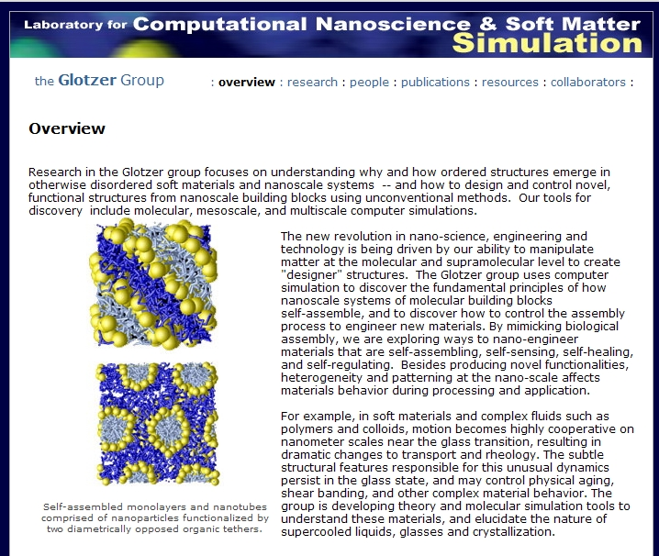
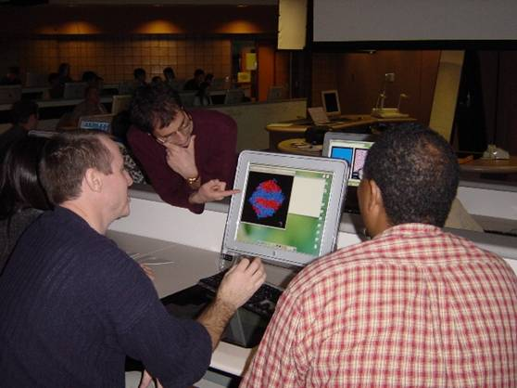
Participants
Research Group
CHE 557

Slide 8
Software & Procedure
Mediawiki software
  Latex
Vocabulary procedure
  Research group: semi-automatic DC metadata capture
  Course: supplemental course resource & part of course assignments

Slide 9
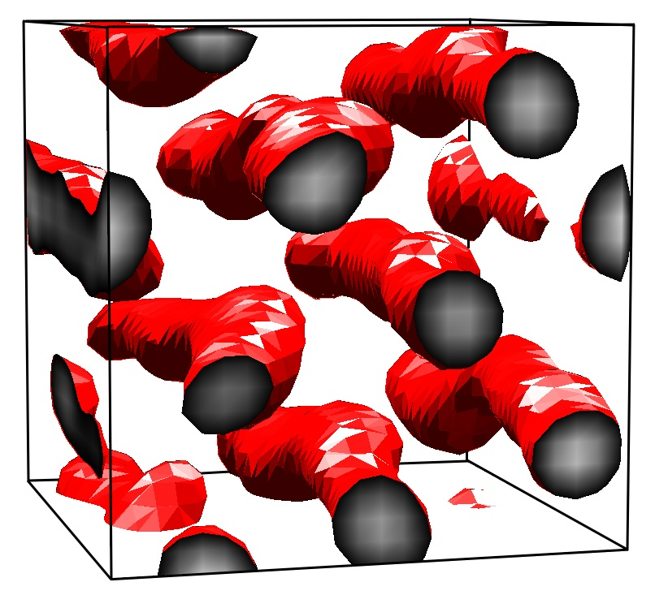
Metadata Capture
<dc:title>Brownian Dynamics simulation of a nanoparticle
aggregating tethered nanosphere</dc:title>
<dc:creator>Chris Iacovella</dc:creator>
<dc:subject>Tethered Building Block</dc:subject>
<dc:subject>Lennard-Jones</dc:subject>
<dc:subject>Brownian Dynamics</dc:subject>
<dc:subject>NVT</dc:subject>
<dc:subject>FENE</dc:subject>
<dc:description>
Number of tethered building blocks = 800;
Number of beads = 7200;
Length of tether = 8;
Diameter of the nanopshere = 2.0;
System temperature = 0.2667;
System volume fraction = 0.25;
Integration scheme to use = Brownian Dynamics, NVT;
Number of Dimensions = 3;
United Atom Bead Spring with Lennard-Jones and FENE;
Phase: Hexagonally packed cylindrical micelles</dc:description>
<dc:publisher>Glotzer group. Depts of Chemical Engineering, Materials Science & Engineering, Macromolecular Science, and Physics,University of Michigan</dc:publisher>
<dc:date>2006-9-19</dc:date>

Slide 10
Results
Public view – launched September 2006
  Number & range of terms
    Currently 71 terms under 12 different categories
    Approximately 70% of the terms have definitions
  Format of entries
    Vary from very brief to considerable detail
  Adding context
    Images, references
    Related items in (e.g., preprints, images)

Slide 11
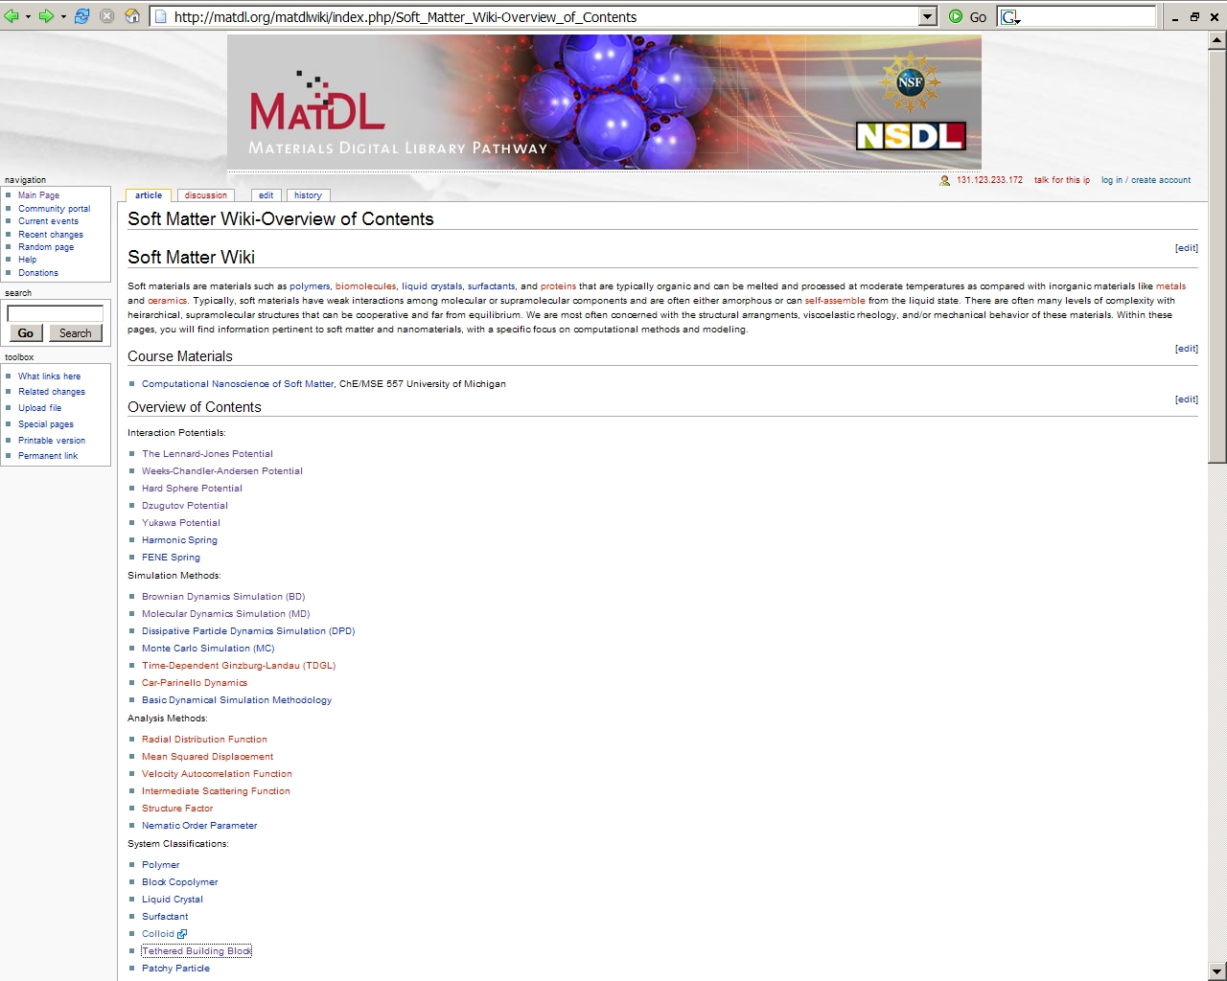
Interaction Potentials:
The Lennard-Jones Potential
Weeks-Chandler-Andersen Potential
Hard Sphere Potential
Dzugutov Potential
Yukawa Potential
Harmonic Spring
FENE Spring
Simulation Methods:
Brownian Dynamics Simulation (BD)
…
System Classifications:
Polymer
Block Copolymer
Liquid Crystal
Surfactant
Colloid
Tethered Building Block

Slide 12
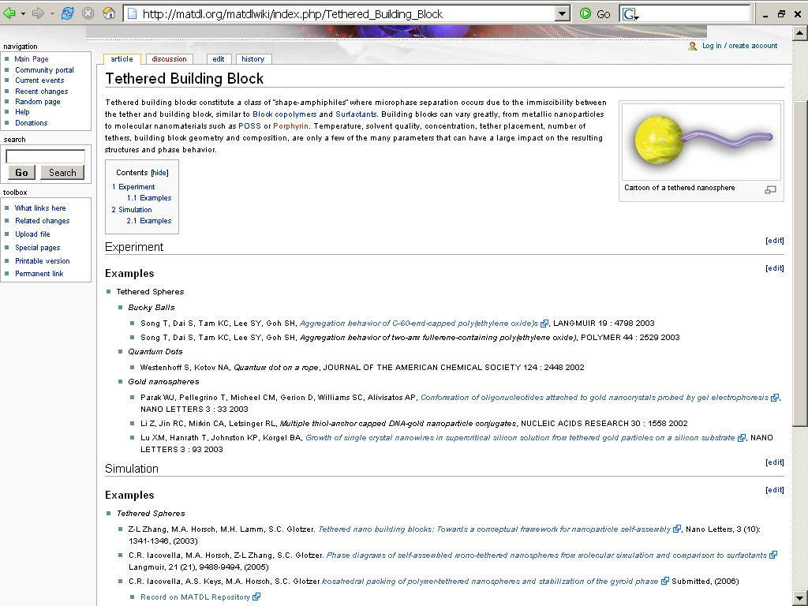
C.R. Iacovella, A.S. Keys, M.A. Horsch, S.C. Glotzer Icosahedral packing of polymer-tethered nanospheres and stabilization of the gyroid phase Submitted, (2006)
  Record on MATDL Repository

Slide 13
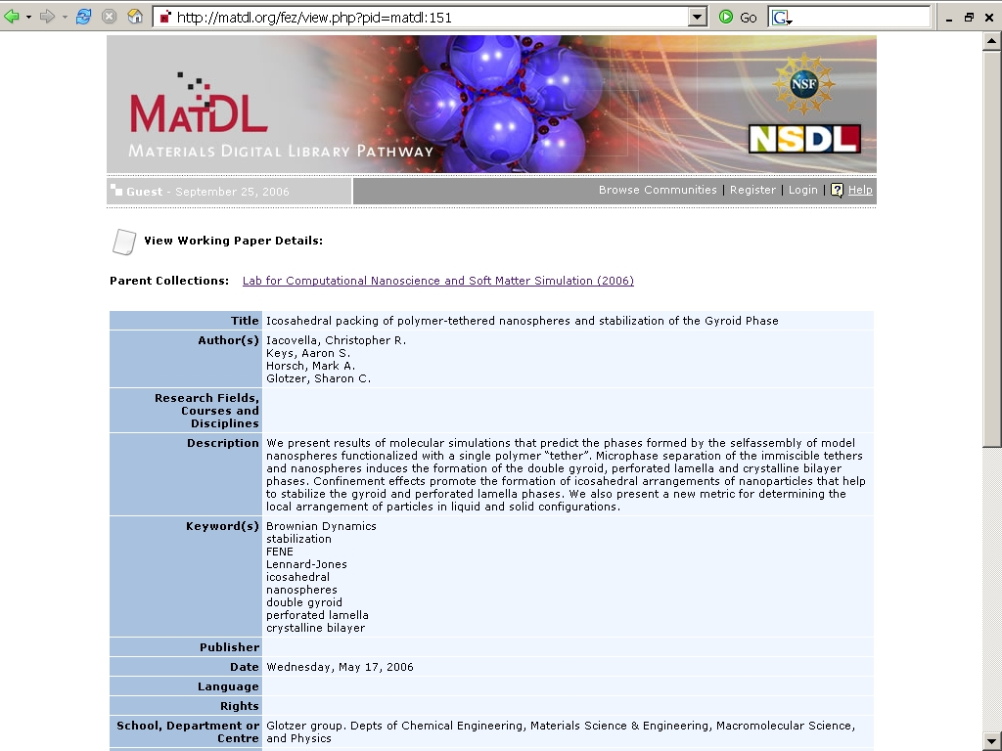

Slide 14
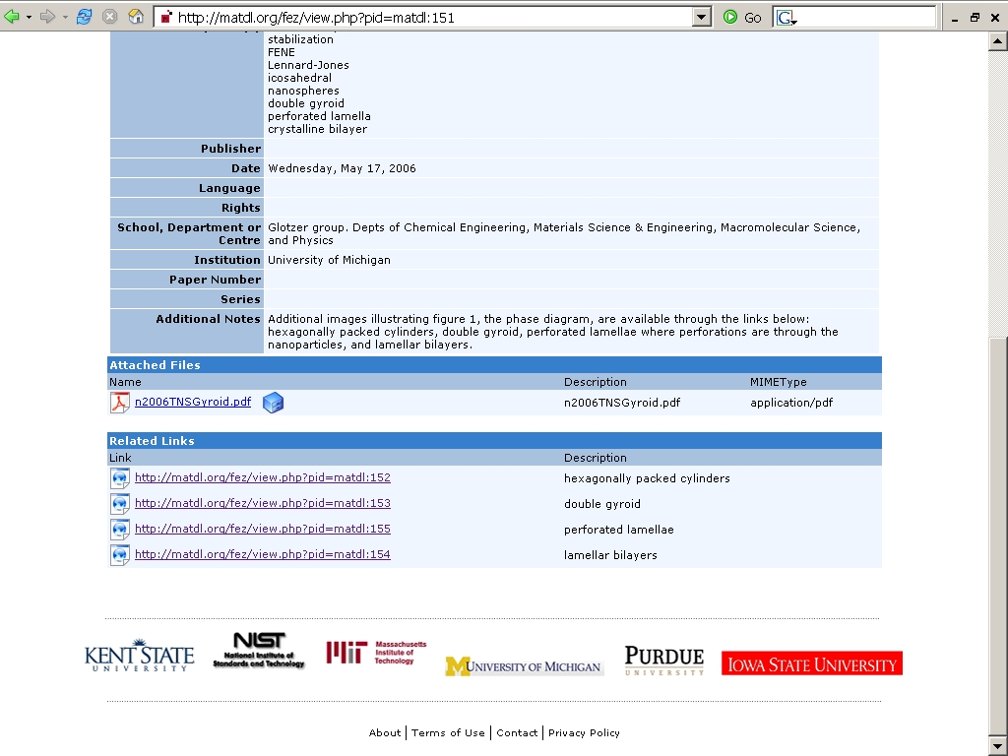
Attached Files
Name Description MIMEType
n2006TNSGyroid.pdf n2006TNSGyroid.pdf application/pdf
Related Links
Link Description
http://testmatdl.lci.kent.edu/fez/view.php?pid=matdl:152 hexagonally packed cylinders
http://testmatdl.lci.kent.edu/fez/view.php?pid=matdl:153 double gyroid
http://testmatdl.lci.kent.edu/fez/view.php?pid=matdl:155 perforated lamellae
http://testmatdl.lci.kent.edu/fez/view.php?pid=matdl:154 lamellar bilayers

Slide 15
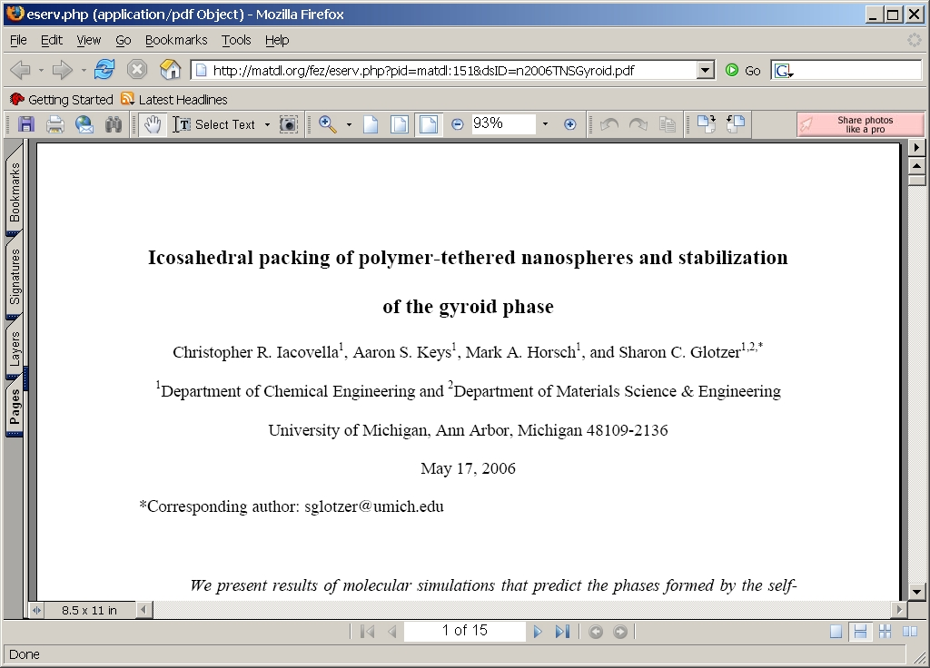

Slide 16
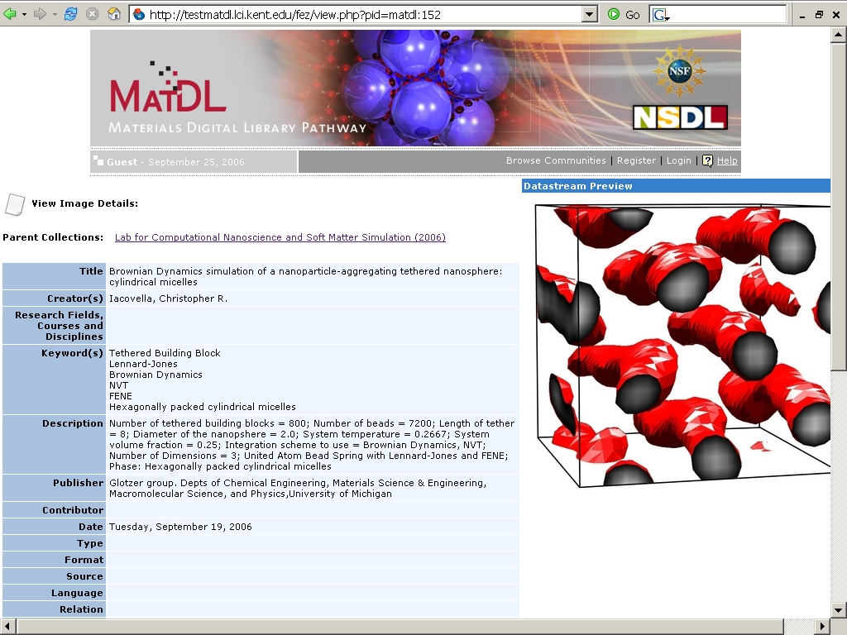

Slide 17
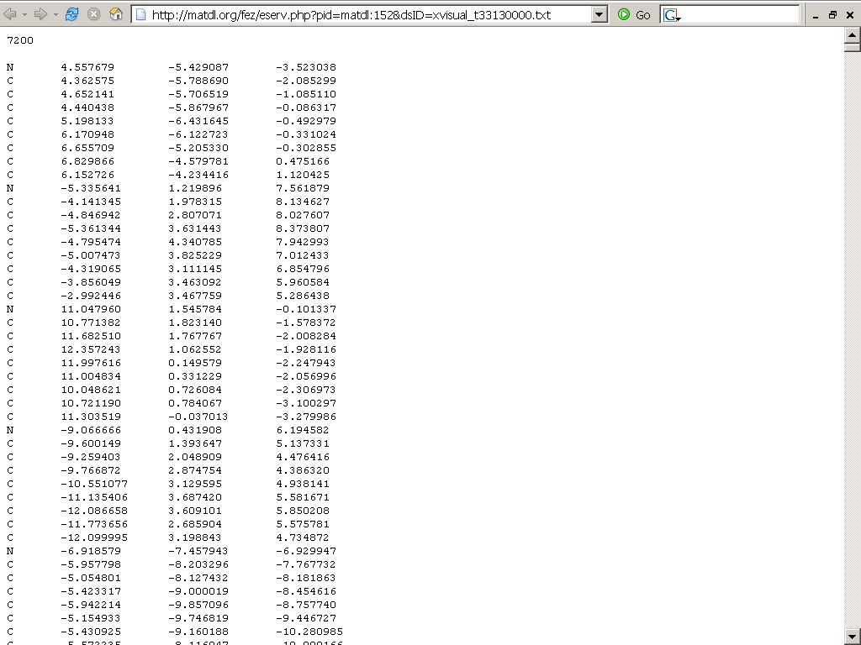

Slide 18
Course view
  Overview, Lectures, Assignments, Books of interest
  Wiki assignments to be reviewed
  Reviewed assignments are submitted to the public view

Slide 19
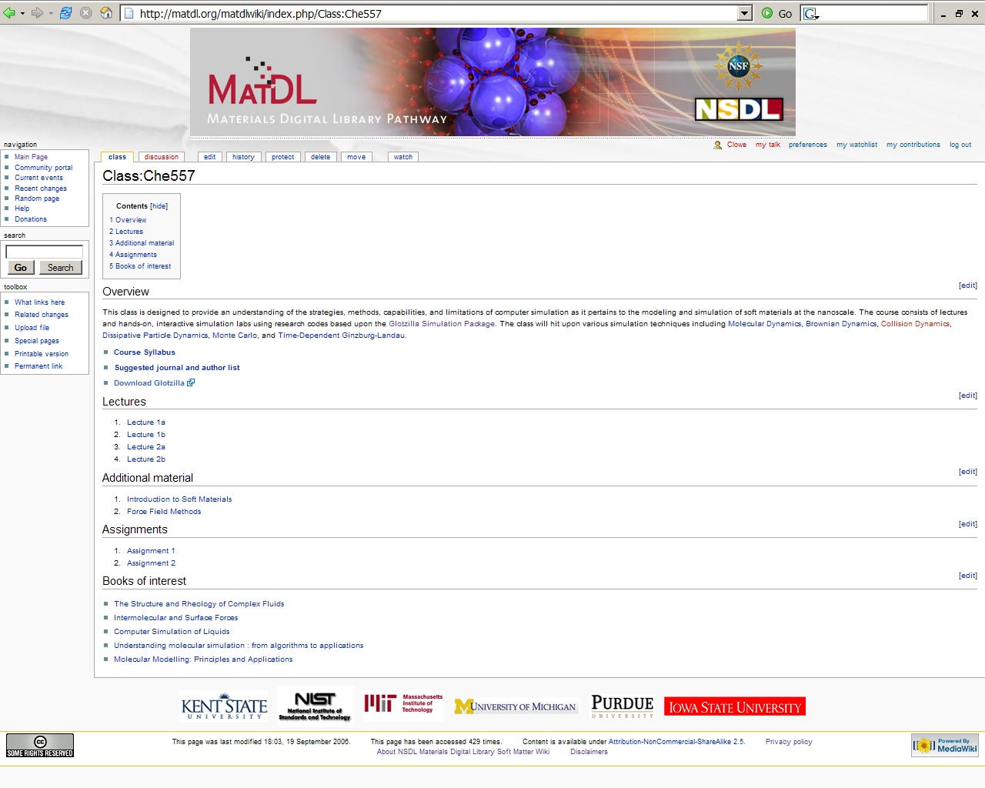

Slide 20
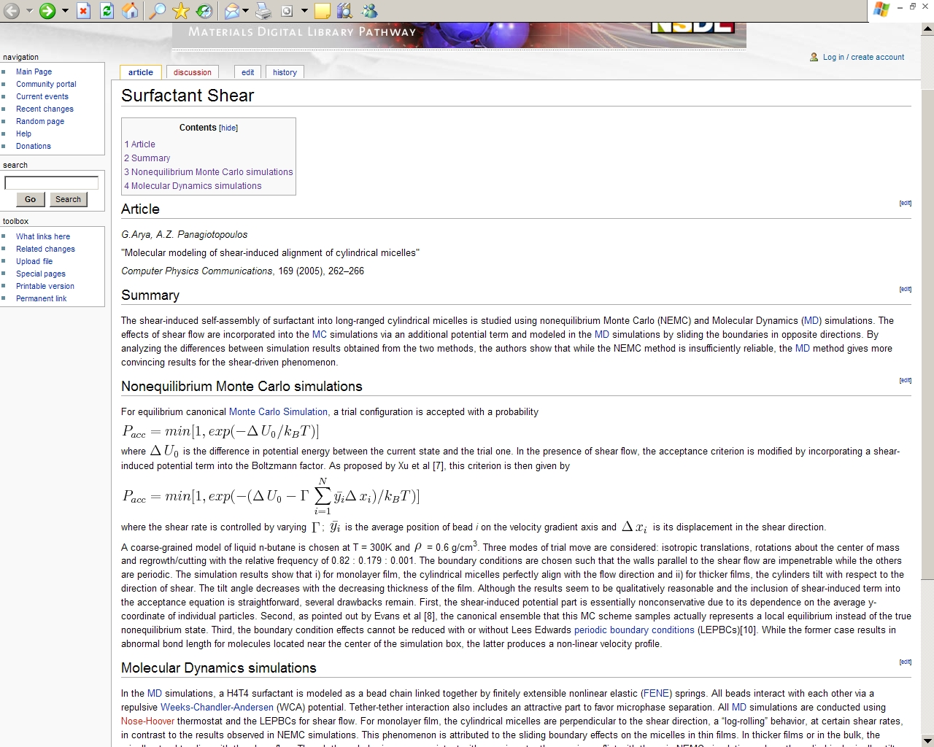

Slide 21
DISCUSSION
Beginning with soft matter simulation
  Expand to: electronic materials, glasses, polymer thin films
Brings repository into wiki presentation
  Move from hard links to plug-in for on-going update of new entries in repository
Metadata feeds terms into wiki and visa versa
Will include experimentalist perspective

Slide 22
Thank you &
Questions? http://matdl.org/matdlwiki
The NSDL Materials Digital Library Pathway is supported by the National Science Foundation DUE-0532831. Any opinions, findings, and conclusions or recommendations expressed in this material are those of the authors and do not necessarily reflect the views of NSF.

